Slide 1
Fabric Technologies
Learning Outcomes:
Software Defined Access (SD-Access): Benefits of SD-Access over traditional campus networks. Components nodes, control plane and data plane.
Software Defined Wide Area Network (SDWAN): Benefits of SDWAN over traditional WAN. Components of SDWAN Orchestration Plane, Management Plane, Control Plane and Data Plane

Slide 2
1.SD-Access
Fabric Technology: Fabric network is overlay network built on underlay network by using overlay tunneling technologies such as VXLAN.
Fabric technology provides host mobility, network automation, segmentation, network virtualization, security with encryption, flexibility, manageability and scalibity than traditional network.
Intent Based Networking (IBN) captures business intent, translates into policies and implements network (physical and virtual) with continuous monitoring to make sure desired business outcome is met.
IBN is achieved by drifting away from hardware centric networks to controller based networks.
Cisco Digital Network Architecture (DNA) now Cisco Catalyst Center is the software solution of IBN that has capabilities to enhance NetOps, AIOps, SecOps and DevOps.
SD-Access and SD-WAN are the components of Cisco Catalyst Centre.
SD-Access is designed for Campus and branch networks.
Benefits of SD-Access:
Network Automation: Network device management with automation, orchestration and management through Catalyst Center.
Network Assurance & Analytics: Proactive prediction of network and security related risks.
Identity Services: ISE integrated to provide contextual access control and segmentation.
Policy Enforcement: SGACL based policy enforcement.
Host Mobility: Wired and wireless mobility
Secure Segmentation: Network that supports guest, corporate, facilities and IoT enabled infrastructure.
Virtualisation: Single physical infrastructure with multiple VRF instances referred as Virtual Networks(VN) with distinct set of access policies.

Slide 3
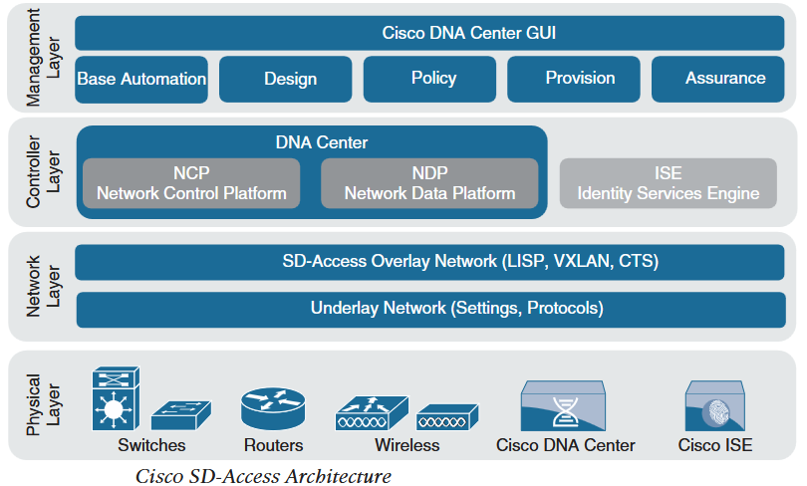
1.SD-Access
Components of SD-Access:
Cisco Campus Fabric Solution
Cisco-validated overlay fabric network that contains control plane, data plane, management plane and policy plane to operate the network infrastructure.
Campus fabric managed with CLI or API such as NETCONF/YANG is known as Cisco Campus fabric solution.
Campus fabric managed with Cisco Catalyst Center is known as SD-Access.
Cisco Catalyst (DNA) Center
Software solution to provide controller layer and management layer functions of SD-Access Architecture.
Cisco SD-Access Architecture
Physical Layer
Physical devices required to deploy SD-Access should support ASIC and FPGA hardware and software support such as VXLAN & LISP.
Components of physical layer
Switches: Provides wired connections to fabric, multiple types of Catalyst and Nexus switches are supported.
Routers: Provides WAN and branch access to fabric. ASR 1000, CSR and ISR including CSRv and ISRv cloud routers are supported.
Wireless : WLCs & Aps provides wireless access to fabric.
Controller Appliances : Cisco Catalyst Center and ISE are two controller appliances.

Slide 4
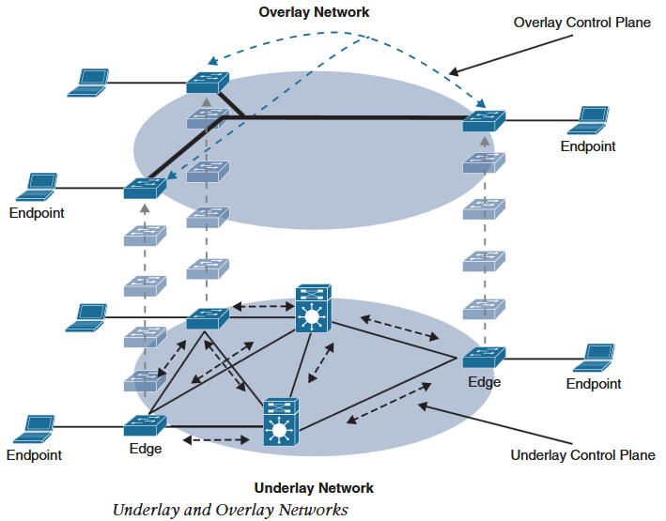
1.SD-Access
Network Layer
Consists of underlay and overlay network working together to transmit data traffic to and from endpoints.
Underlay network is the underlying physical network that transports data packet for the fabric endpoints.
Overlay is the virtual (tunneled) network that virtually interconnects fabric nodes and devices.
Overlay network abstracts the inherent complexity of underlay network.
Underlay Network
Configure underlay network to ensure performance, scalability and high availability.
Recommended underlay is layer 3 routed access campus design with IS-IS as IGP.
Two models of underlay are supported:
Manual Underlay: Underlay network configured manually using CLI and API.
This method provides customisation benefit and third-party IP network support.
Automated Underlay: Network managed and configured through Catalyst Center LAN Automation feature.
It creates a routed access campus network with IS-IS as IGP.
It uses Cisco Network Plug and Play features to deploy both unicast and multicast routing configuration.

Slide 5
1.SD-Access
Overlay Network (SD-Access Fabric)
SD-Access fabric provides segementation based on access policy, host mobility, and enhanced security.
SD-Access fabric is fully automated regardless of underlay model.
Three basic planes of operation in SD-Access fabric:
SD-Access Fabric Control Plane: Based on LISP
LISP maps Endpoint IDs to RLOCs and this mapping is stored in central mapping database Mapping Server (MS).
Each router only stores it’s local route and queries MS for remote destination EIDs.
LISP provides address agnostic mapping (ipv4/ipv6. and/or MAC), dynamic wired or wireless host mobility, and built in segmentation with VRF instances.
SD-Access fabric implements enhancements from original LISP specification such as distributed Anycast gateway, VN Extranet and Fabric Wireless.
SD-Access Fabric Data Plane: Based on VXLAN
It encapsulates MAC in IP/UDP, thus SD-Access data packets can be transported by any IP network (legacy and third party).
Such encapsulation makes VXLAN to support layer 2 and layer 3 overlay.
Original VXLAN specification is enhanced to support Cisco TrustSec Scalable Group Tags (SGTs). TrustSec Security Group Tags are called Scalable Group Tags in SD-Access.
A new 4 bytes header field is added to accommodate 64,000 SGTs.
The new format is called VXLAN Group Policy Option (VXLAN-GPO).

Slide 6
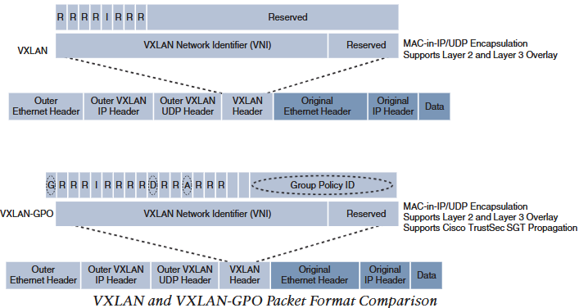
1.SD-Access
SD-Access Fabric Policy Plane: Based on Cisco TrustSec (CTS)
Authenticated users are tagged with SGT, network policy (ACLs,QoS and Policy Based Routing (PBR)) is applied throughout the fabric based on those SGT instead of MAC, ipv4 and ipv6.
TrustSec SGTs provide below advantages in SD-Access fabric:
Supports both network based segementation using VNs (VRF instances) and group based segmentation (policies).
Network address agnostic group based policies.
Dynamic enforcement of policies regardless of wired or wireless and location.
Policy construct over legacy or third party IP network.
Extended policy enforcement by transporting SGT to cloud or data centre by use of SXP and SGT capable hardware.
Group Policy ID: 16 bit identifier that carries SGT tags
Group Based Policy Extension (G Bit): 1 : SGT is carried in Group Policy ID, 0 : No SGT carried.
Don’t Learn (D Bit): 1 indicates egress Virtual Tunnel Endpoint (VTEP) should not learn source address of the encapsulated frame.
Policy Applied Bit (A-Bit): Set to 1 when policy is already applied to the packet, if set to 0, policy is not applied to the packet. This bit is only relevant when G-Bit is set.

Slide 7
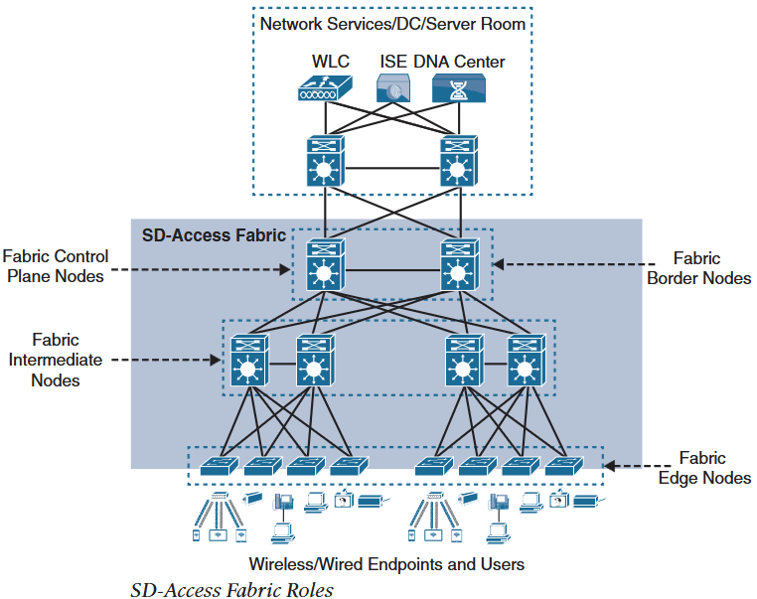
1.SD-Access
SD-Access Fabric Roles and Components
Each SD-Access Fabric node must be assigned one or more of the following five basic roles:
Control Plane Node: Contains settings, protocol and mapping table to provide EID-to-RLOC mapping system for the overlay fabric.
Fabric Border Node: Connects external layer 3 networks to SDA fabric.
Fabric Edge Node: Connects endpoints to SDA fabric.
Fabric WLAN Controller: Connects wireless endpoints and APs to SDA fabric.
Intermediate Nodes: Intermediate routers or extended switches that only provide underlay transport service and does not provide any SDA fabric services.

Slide 8
1.SD-Access
Control Plane Node
LISP Map Server (MS) with enhanced services such as fabric wireless and SGT mapping.
It maps EID locations to fabric edge node or fabric border node.
It receives registration from edge node and fabric mode WLCs.
And resolves map requests received from edge and border node to EIDs location.
Fabric Border Node
LISP Proxy Tunnel Routers (PxTRs) that connect external layer 3 network to SDA fabric.
They translate reachability and policy information from one domain to another such as VRF and SGT.
There are 3 types of Border Nodes:
Internal Border (rest of company): Connects only to known areas of the organization, such as Firewall, WLC and data center.
Default Border (Outside): Connects only to unknown areas outside the organisation.
It is configured with default route to reach external network such as internet and public cloud that are not known to Control Plane Node
Internal + Default Border (Anywhere): Border node that combines internal and default border as one.

Slide 9
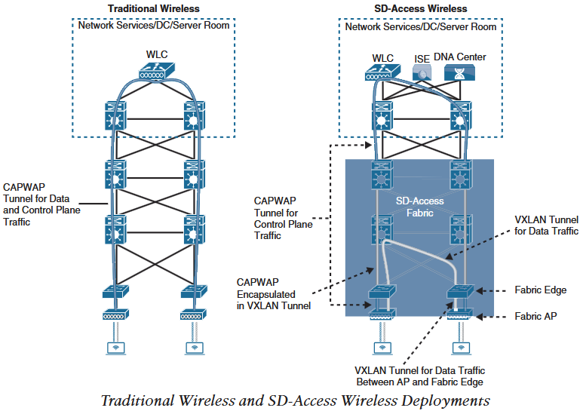
1.SD-Access
Edge Node
LISP Tunnel router (xTR) that provides onboarding and mobility to endpoints and network devices (fabric enabled APs and WLCs) to SDA fabric.
It provides anycast gateway, authentication, TrustSec tagging and policy enforcement and assignment to overlay host pools (static or DHCP).
Edge node first performs above task and then registers the EIDs to Control Plane Node.
It performs encapsulation and de-encapsulation.
Fabric Wireless Controller (WLC)
Connects APs and wireless endpoints to the fabric.
Fabric WLC is external to fabric and is connected to the fabric through internal border node.
It performs PxTR task and can be thought of as edge node for wireless clients.
Control plane node maps wireless endpoint EIDs to current fabric AP and edge node where AP is connected.
Example EID-to-RLOC (10.10.1.100, (AP-1,SW1))
Traditional wireless has a CAPWAP tunnel for both control plane and data plane traffic between AP and centralised WLC
SD-Access wireless has CAPWAP tunnel between fabric AP and WLC for control plane and data traffic is transmitted in a VXLAN tunnel.
SDA CAPWAP tunnel for control plane is encapsulated in VXLAN tunnel in the fabric and is a normal traditional CAPWAP tunnel in the legs outside of the fabric.

Slide 10
1.SD-Access
SD-Access terminologies and Concepts
Virtual Network (VN): VN in SDA fabric is VRF instance that is mapped to VXLAN Network Identifier (VNID) in VXLAN header in the SDA data plane.
In control plane it is mapped to a LISP instance.
Host Pool: Pool of IP addresses (subnet) from which SDA endpoints are assigned EIDs.
Edge nodes have SVI for each host pool to be used by endpoints and users as default gateway. EIDs can be assigned dynamically during 802.1x authentication or statically using per port configuration.
Scalable Group : Group of endpoints with similar policies.
SDA policy plane assigns host to scalabe group using TrustSec SGTs. Scalable group assignment can be dynamic during authentication using AAA or static using per fabric edge port.
Same scalable groups are either configured on each edge and border node or are defined in Catalyst Center or ISE and are pushed to edge and border node using Cisco TrustSec.
Fabric edge and border node include SGT tag ID on VXLAN header, which are propagated through the fabric and policy enforcement is applied using Cisco TrustSec.
By default scope of scalable group is per VN and they have direct one-to-one relationship with host pools.
Anycast Gateway: Each edge node is assigned with same SVI (IP and MAC) and host pool (subnet) across the SDA fabric.
For example 10.10.10.0/24 subnet will be configured at each edge node and endpoints in this host pool can connect to the fabric from any edge node, thus providing host mobility.
This stretches the subnet across the fabric which makes IP address assignment simple.
Therefore, less but larger subnets should be deployed.

Slide 11
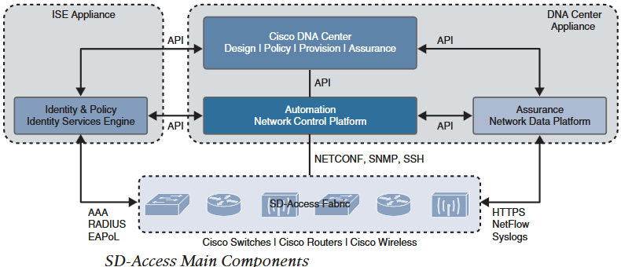
1.SD-Access
Controller Layer: Provides management subsystem for management layer. Catalyst Center (DNAC) and ISE interoperate to provide controller layer functions. Picture in left shows how they interact with each other and other main components of SDA fabric.
Three main components in Controller Layer:
Network Control Platform (NCP): This subsystem integrated into DNAC provides automation and orchestration of physical and network layer.
It uses NETCONF/YANG, SNMP and SSH/Telnet to manage and configure physical layer devices and provides contextual automation information to management layer, NDP and ISE.
Network Data Platform (NDP): Integrated directly into DNAC, it is a data collection, analytics and assurance subsystem.
It analyzes and correlates various network events through multiple sources such as Netflow, Syslog and SPAN.
It provides contextual analytics information to ISE and DNAC and operational status based on contextual analytics to management layer.
Cisco Identity Services Engine (ISE): Basically provides identity (NAC) and policy (Scalable group) services to physical and network layer and endpoints.
ISE collects and uses contextual information from NCP, NDP and other third-party Identity Provider (Idp) to place profiled endpoints to scalable groups and host pools.
This contextual information is shared to management layer for user management.

Slide 12
1.SD-Access
Management Layer: User Interface or User Experience UI/UX layer.
It presents contextual and other information received from Controller layer to the user/Admin in a centralized dashboard.
It abstracts the complexity of other layers such as LISP,VXLAN, ISE, NETCONF and presents a simple GUI to manage and operate network in the form of workflows.
Catalyst Centre (DNAC) workflows are as follows:
Design Workflow: Provides tools to logically define a SDA fabric.
Design Hierarchy: Setup geolocation, building and floorplans and associate them to unique Site ID.
Network Settings: Setup network services (DHCP, DNS, AAA), device credentials, IP management and wireless.
Image Repository: Used to manage software images, maintain software update, download and deploy software images.
Network Profiles: Used to define LAN, WAN and WLAN profiles and apply them to sites.
Policy Workflow: Logically define Catalyst Center policy.
AI Endpoint Analytics: Endpoint visibility solution that allows to profile endpoints security score that can be used to apply policy.
Group Based Access Control : Used to manage group based access control, same as SGACL. Catalyst Center integrates with ISE to simplify management of GBAC.
Application: Configure QoS policies for applications.
Traffic Copy: Create traffic copy policy using ERSPAN for monitoring and troubleshooting.

Slide 13
1.SD-Access
Provision Workflow: Provides tools to deploy SDA fabric. This workflow is divided into three subsection.
Network Devices: Contains Inventory, PnP, LAN Automation and Inventory Insights.This helps to assign devices to sites, confirm or update software version and provision network underlay configuration.
SD Access: Contains Zero Trust Overview, Fabric Sites, Virtual Networks and Transits. This helps to create Zero Trust policy based fabric sites through device role assignment (control plane, border, edge),host onboarding (static or dynamic host pool assignment), virtual network creation and device association, and interconnection of fabric site to each other and with non-fabric sites through transit network.
Services: It contains fabric site services such as Application visibility, Security insights and Site to Site VPN.
Assurance Workflow: Contains tools to manage the SDA fabric.
Dashboards: Create dashboards to monitor different components of the fabric such as specific network device, client, site or whole fabric.
Client 360: Used to monitor and resolve client specific issues such as onboarding and application issues.
Device 360: Used to monitor and resolve device specific issues such as resource usage, latency and loss.
Issues: Used to track and resolve open issues(reactive) and/or developing trends (proactive) for clients and devices.

Slide 14
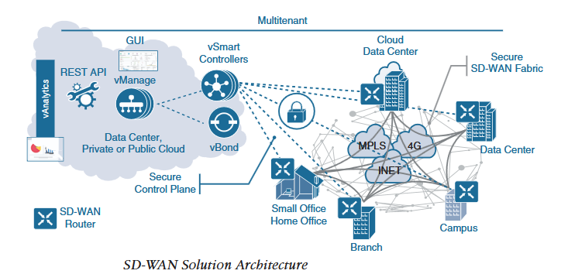
2.SD-WAN
Advantages of SD-WAN
Lower cost and reduce risk with simple WAN automation and orchestration.
Extend branch and campus network seamlessly into public cloud.
Provide optimal user experience for SaaS applications
Leverage transport independent WAN, meaning can be deployed over underlay transport network such as Internet, MPLS, 4G/5G and Satellite.
Enhance application visibility to make intelligent path selection decisions.
Provide end-to-end WAN traffic segmentation and encryption.
Cisco SD-WAN Offerings:
Cisco SD-WAN (based on Viptela): Preferred solution for organization that require granular segmentation, advanced security, advanced routing, complex topology and public cloud connectivity.
Meraki SD-WAN: Preferred solution that require Unified Threat Management (UTM) through SD-WAN devices and for organizations that are already with Meraki.
Above picture shows SD-WAN can be deployed over any type of transport network.
It also shows that some components of SD-WAN such as vBond, vManage and vSmart Controllers can be deployed in Data Centre, Private or Public cloud.

Slide 15
2.SD-WAN
Main components of Cisco SD-WAN : Cisco SD-WAN has four main components and an optional Analytics component.
vManage NMS: Single pane of glass GUI to centrally manage SD-WAN.
vSmart Controller: Brains of SD-WAN
Authenticates every SD-WAN router that comes online with pre-installed credentials.
It creates a permanent Datagram Transport Layer Security (DTLS) tunnel with SD-WAN routers and runs Overlay Management Protocol (OMP).
OMP is a proprietary overlay protocol similar to BGP that can advertise routes, keys and policies to manage SD-WAN fabric.
VSmart Controllers learn routes from SD-WAN routers and other controllers and similar to BGP, it processes those routes to calculate best path and advertises Network Reachability Information to SD-WAN routers in the fabric.
Controllers also implement policies such as segmentation per VPN topology, traffic engineering and service chaining configured on vManage.
Controllers work together with vBond to authenticate SD-WAN routers and to orchestrate SD-WAN fabric.
vBond Orchestrator: It authenticates vSmart controllers and SD-WAN routers and orchestrates connectivity between them.
This is the only device that needs to have public IP in the SD-WAN fabric.
It is basically a SD-WAN router that only performs below orchestration functions.
Control plane connection: vBond has permanent DTLS tunnel with vSmart controllers and SD-WAN routers. Authentication of vSmart and cEdge is done using certificates and RSA cryptography.
NAT traversal: Facilitates connection between vSmart and cEdge using peer to peer connection technology when both or one of them are behind NAT device.
Load balancing: On fabric with multiple vSmart controllers, it load balances connection of SD-WAN routers between vSmart controllers.

Slide 16
2.SD-WAN
SD-WAN Routers (vEdge and cEdge):
Available as hardware, software, cloud or virtualised, they sit at perimeter of the site to provide essential WAN, Security and multicloud capabilities.
They support standard features such as OSPF, BGP, ACLs,QoS, and routing policies in addition to SD-WAN control and data plane functionalities.
They form a DTLS tunnel with vSmart controllers and form OMP neighborship over the tunnel to exchange routing information.
SD-WAN routers create a IPSec session between each other in the fabric.
They also perform site-local duties such as decision routing, high availability, ARP and ACL management.
Two different options available for SD-WAN routers:
vEdge: Based on original Viptela software.
CEdge: Viptela software integrated with Cisco IOS-XE. IOS-XE for SD-WAN routers is different than original IOS-XE as only SD-WAN relevant features are imported. IOS-XE for SD-WAN is supported on ISR, CSR, ASR1K, Enterprise Network Compute Systems (ENCS) and cloud enabled ISRv and CSRv platforms.
cEdge and vEdge Security features
Feature | cEdge | vEdge
Cisco AMP and AMP Threat Grid | Yes | Yes
Enterprise Firewall | Yes | Yes
Cisco Umbrella DNS Security | Yes | Yes
URL Filtering | Yes | No
Snort IPS | Yes | No
Embedded platform security (including Cisco Trust Anchor module) | Yes | No
vBond Analytics: Optional Analytics component with below capabilities.
Visibility into applications and infrastructure across WAN by monitoring issues across organizations to correlate and inform Service Provider about underlay network problems.
Forecasting and What-if analysis of the fabric.
Intelligent recommendation by monitoring bandwidth utilization at sites to recommend upgrade or downgrade of the circuit.

Slide 17
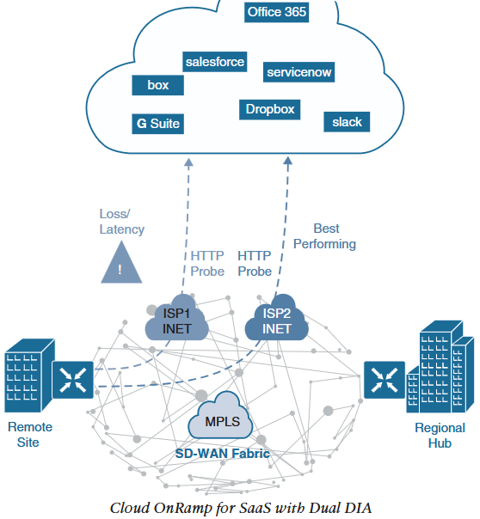
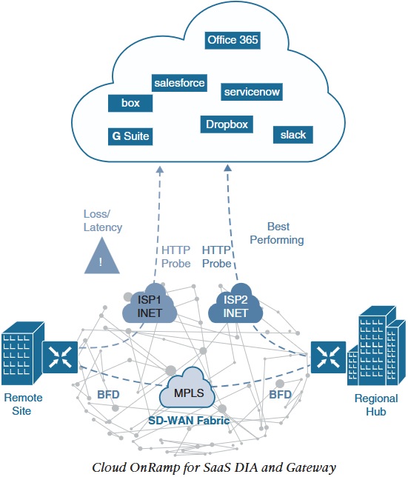
2.SD-WAN
SD-WAN Cloud OnRamp: SD-WAN functionalities to provide optimal SaaS application experience and cloud infrastructure (IaaS) connectivity.
Cloud OnRamp for SaaS: Continuously monitors SaaS application diverse paths and selects best path to provide optimal QoE.
The quality of SaaS application connection is quantified by using Viptela QoE in the scale of 0 (worst) to 10 (best).
First picture shows Remote Site with dual Direct Internet Access (DIA) with ISP1 and ISP2 to public cloud.
In such deployment, when Cloud OnRamp for SaaS is configured on vManage, remote site SD-WAN router sends continuous HTTP probe to SaaS to measure Loss/Latency across both DIA.
The connection with best performance metrics (ISP2 in this case) is selected to forward SaaS traffic. Probing continues to dynamically adjust traffic path between ISPs.

Slide 18
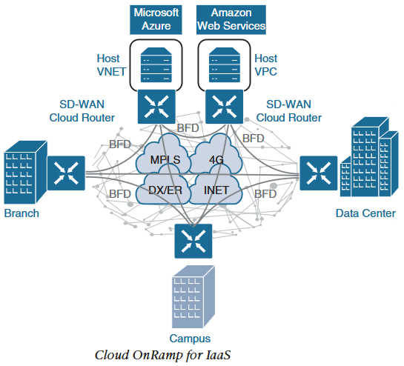
2.SD-WAN
Second picture shows Remote Site with single DIA and a designated Gateway node at regional hub.
On configuring Cloud OnRamp on remote site and Gateway node, both routers send HTTP probe to SaaS to measure the quality.
Bidirectional Forwarding Detection (BFD) protocol runs through DTLS session between remote site and Gateway node to detect path liveliness and measure quality (loss/latency/jitter and IPSec path MTU).
Gateway node shares it’s HTTP connection characteristics with remote site over OMP message exchange via vSmart controller.
Remote site calculates best path for the SaaS application by comparing it’s own HTTP probe via ISP1 and connection characteristics via Gateway node (HTTP via ISP2 and BFD combined).
Cloud OnRamp for IaaS: Multicloud is used to host certain applications in on-prem data centres, some in private cloud and other in public cloud such as AWS, Azure or Gcloud. This provides flexibility to enterprises in using compute infrastructure as required.
By using SD-WAN routers it is possible to extend enterprise connectivity, end-to-end segmentation, zero-trust security and QoS policies into the public cloud Infrastructure.

Slide 19
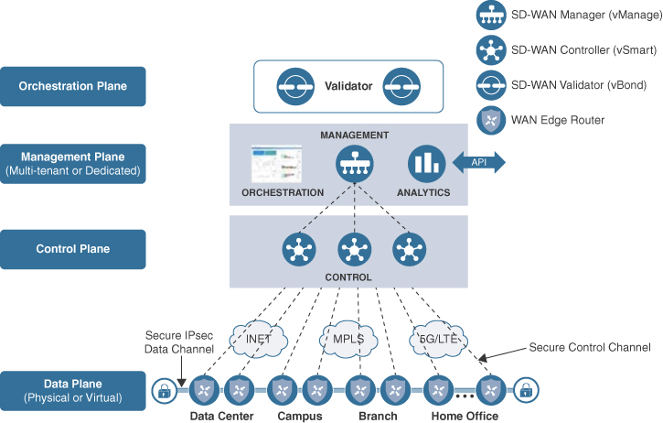
2.SD-WAN
SDWAN-Sample Chapter cisco press book

